Slide 1

CAREER OPPORTUNITIES
https://www.calhr.ca.gov/Pages/Job-Seekers.aspx

Slide 2
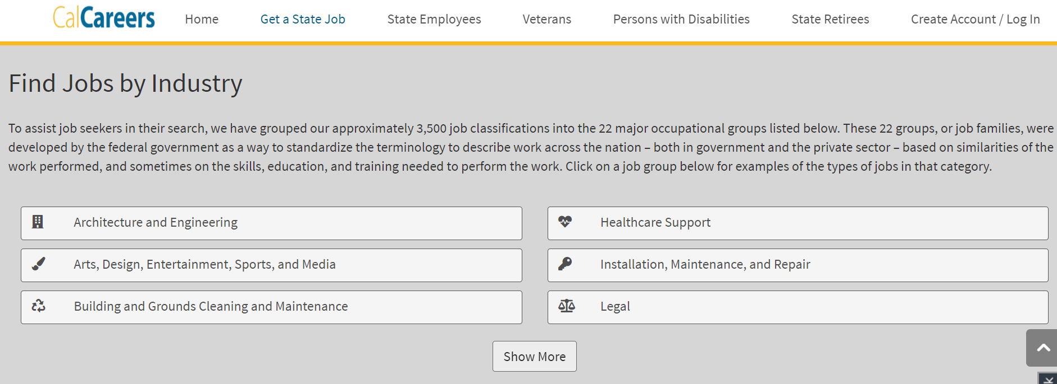
CAREER OPPORTUNITIES
https://www.calcareers.ca.gov/CalHRPublic/Landing/NewToStateservice.aspx

Slide 3
How to apply
Search Pay attention to location
Exam/Assessment Give yourself credit
Apply Watch for Statement of Qualification Requirements
Computer Science Jobs: IT Associate, IT Specialist, Telecommunications Engineer

